Slide 1
Fair Grading Algorithms for Randomized Exams
Jiale Chen, Jason Hartline and Onno Zoeter
FORC 2023

Slide 2







Traditional Exam and Simple Averaging
Traditional exam: same question set
Simple averaging: ratio of correct answers
$$\frac{1}{3}$$

Slide 3








Randomized Exam
Problem of traditional exam design: risk of cheating
Solution: random question assignment
Problem of simple averaging: ignorance of different question difficulties

Slide 4

Outline
Problem setting
Formal definition of randomized exams
How to measure the fairness of an algorithm?
Simulation result
Visualization of simple averaging’s unfairness
Our algorithm and theoretical result
How many questions do we need to ask?
$$\text{alg} \text{v}\text{.}\text{s}\text{. }\text{opt}$$
Simple Averaging
Our Algorithm

Slide 5

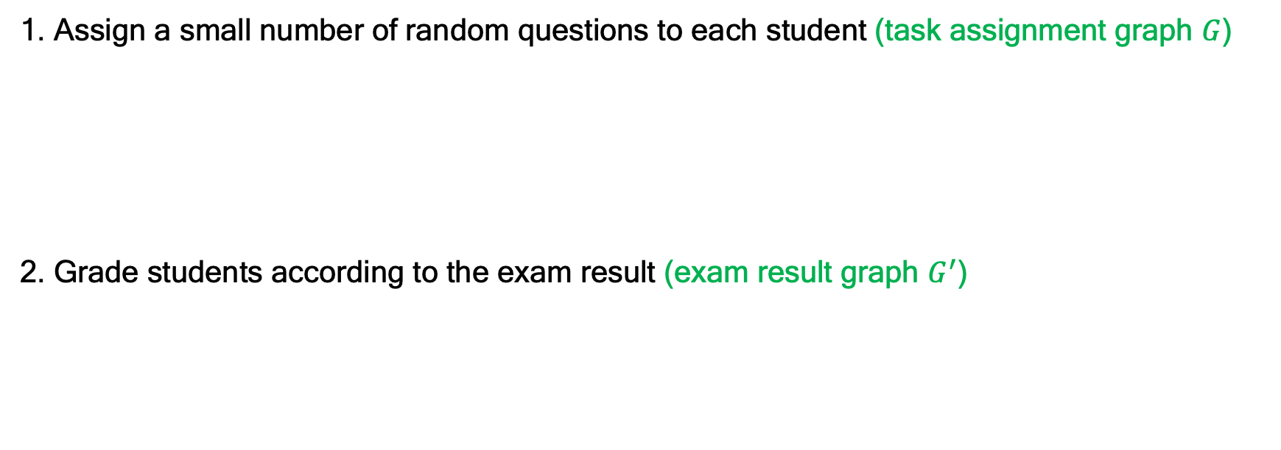

Randomized Exam
1. Assign a small number of random questions to each student (task assignment graph $G$)
2. Grade students according to the exam result (exam result graph $G^{′}$)
$$\sim ℬ\left(n, m,d\right)$$
$\sim$model in theory/simulation

Slide 6






Fairness
Algorithm: mapping from exam result to grades
Benchmark: expected grade in traditional exam
Source of randomness:
Ex-ante Bias:
Ex-post Bias:
Ex-post Error:
Best-of-Both-Worlds fairness
in fair allocation

Slide 7
Outline
Problem setting
What is a randomized exam?
How to measure the fairness of an algorithm?
Simulation result
Visualization of simple averaging’s unfairness
Our algorithm and theoretical result
How many questions do we need to ask?
$$\text{alg} \text{v}\text{.}\text{s}\text{. }\text{opt}$$

Slide 8
A Visualization of Simple Averaging’s Ex-post Unfairness
Setting: 35 students, 10 out of 22 questions
Ex-post grade deviation: expected grade over random mistakes - benchmark
Simple Averaging
Our Algorithm

Slide 9
Ex-post Error and Bias-Variance Decomposition
Thm (Bias-Variance Decomposition).
Ex-post Error = Ex-post Bias + Variance
Setting: 35 students, 10 out of 22 questions
Takeaway: significantly smaller ex-post bias + slightly larger variance.
 | Ex-post Bias | Variance | Ex-post Error
Ours | 0.00004 | 0.0188 | 0.0188
Avg | 0.00331 | 0.0170 | 0.0203
Ours-Avg | -0.00327 -99% | 0.0018 +10% | -0.0015 -8%

Slide 10
Outline
Problem setting
What is a randomized exam?
How to measure the fairness of an algorithm?
Simulation result
Visualization of simple averaging’s unfairness
Our algorithm and theoretical result
How many questions do we need to ask?
$$\text{alg} \text{v}\text{.}\text{s}\text{. }\text{opt}$$

Slide 11
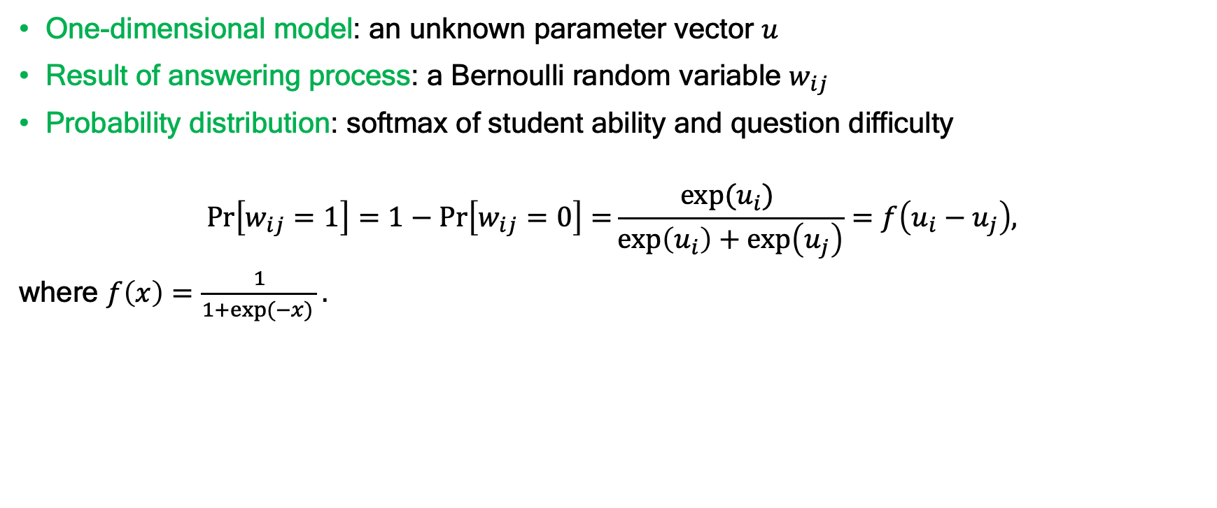
Model [Bradley and Terry 1952, Rasch 1993]
Noisy Comparison
Item Response Theory (IRT)
One-dimensional model: an unknown parameter vector $u$
Result of answering process: a Bernoulli random variable $w_{ij}$
Probability distribution: softmax of student ability and question difficulty
$$\operatorname{Pr}\left[w_{ij}=1\right]=1−\operatorname{Pr}\left[w_{ij}=0\right]=\frac{\exp{{(u}_{i}) }}{\exp\left(u_{i}\right)+\exp\left(u_{j}\right)}=f\left(u_{i}−u_{j}\right),$$
where $f\left(x\right)=\frac{1}{1+\exp{(−x)} }.$
IRT models and related methods are used in standardized tests including SAT and GRE to generate score scales for alternative forms [An and Yung, 2014]. They are at an entirely different scale.

Slide 12

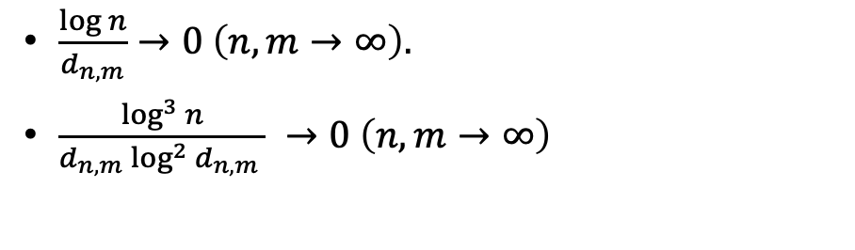
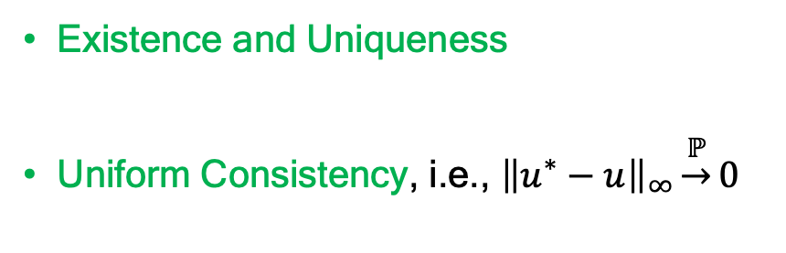
Maximum Likelihood Estimators
$$n=|S|$$
$$m=|Q|$$
$u$: parameters
$u^{∗}$: MLEs
$$α_{n,m}=\max_{i,j∈S∪Q}u_{i}−u_{j}$$
$$d_{n,m}=\deg_{i}{∀i∈S}$$
Thm [Zermelo 1929, Ford 1957]
The MLEs exist and are unique iff the exam result graph is strongly connected.
Our theoretical result of MLE
Property
Condition (when $n=m, α=\text{O}\left(1\right)$)
Existence and Uniqueness
Uniform Consistency, i.e., ${\left\|u^{∗}−u\right\|}_{∞}\underset{→}{ℙ}0$
$\frac{\log{n}}{d_{n,m}}→0 \left(n,m→∞\right).$
$\frac{\log^{3}{n}}{d_{n,m}\log^{2}{d_{n,m}} } →0 \left(n,m→∞\right)$
Our theory is an extension of [Han et. al, 2020] which focuses on Erdős–Rényi graphs.

Slide 13


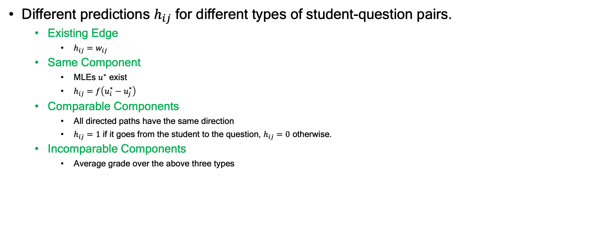
Our Algorithm
Different predictions $h_{ij}$ for different types of student-question pairs.
Existing Edge
$h_{ij}=w_{ij}$
Same Component
MLEs $u^{∗}$ exist
$h_{ij}=f\left(u_{i}^{∗}−u_{j}^{∗}\right)$
Comparable Components
All directed paths have the same direction
$h_{ij}=1$ if it goes from the student to the question, $h_{ij}=0$ otherwise.
Incomparable Components
Average grade over the above three types

Slide 14
Comparison between Algorithms
Our Algorithm
Simple Averaging
Gives prediction on every student-question pair
Uses more structural information about the exam result graph
Gives prediction only on final grade
Only takes local information of the students, i.e., their indegrees and outdegrees
Thm (Ex-post Error).
In the case where the MLEs exist and are unique, we have $∀i∈S, {\left({\text{alg}}_{i}−{\text{opt}}_{i}\right)}^{2}≤\frac{1}{4}{\left\|u^{∗}−u\right\|}_{∞}^{2}$.

Slide 15
Extension and Future Direction
Extend from one-dimensional model to multi-dimensional model
Provide a simple and clear explanation to students for practical use

Slide 16

Thank you
Jiale Chen
Stanford University
jialec@stanford.edu

Slide 17
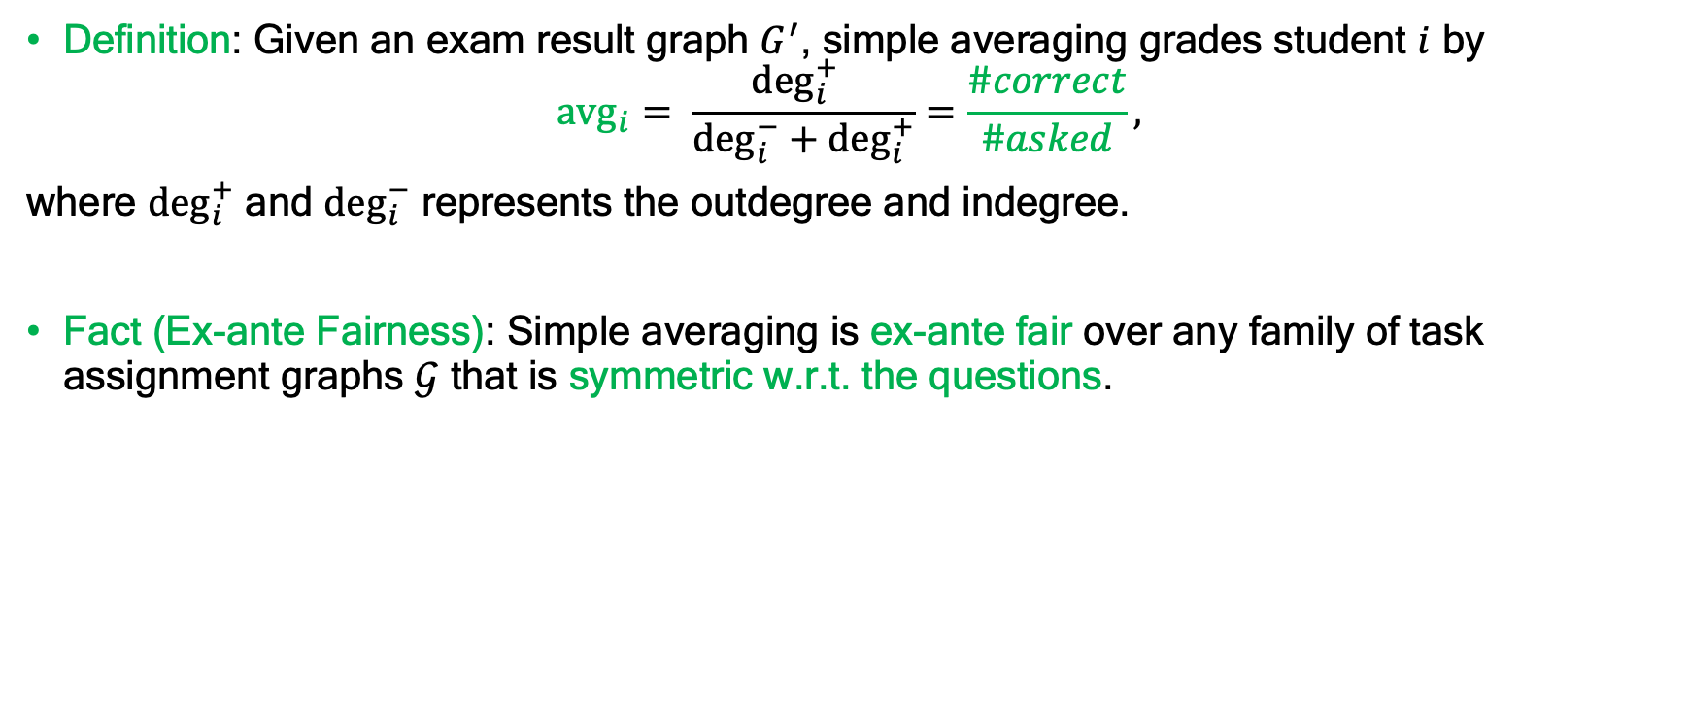
Simple Averaging
Definition: Given an exam result graph $G^{′}$, simple averaging grades student $i$ by
$$a{\text{vg}}_{i}= \frac{{\text{deg}}_{i}^{+} }{{\text{deg}}_{i}^{−}+{\text{deg}}_{i}^{+}}=\frac{\#correct}{\#asked},$$
where ${\text{deg}}_{i}^{+}$ and ${\text{deg}}_{i}^{−}$ represents the outdegree and indegree.
Fact (Ex-ante Fairness): Simple averaging is ex-ante fair over any family of task assignment graphs $𝒢$ that is symmetric w.r.t. the questions.

Slide 18
Data Description
35 students, 22 questions
Complete bipartite task assignment graph
Strongly connected exam result graph – MLE exists

Slide 19

Simulation on Ex-post Bias: The Effect of the Degree Constraint
Random task assignment graphs, Random exam results
Consider
the expected maximum ex-post bias, i.e., $𝔼_{G}\left[\max_{i∈S}{{\left(𝔼_{w}\left[\text{al}{\text{g}}_{i}\right]−\text{op}{\text{t}}_{i}\right)}^{2}}\right]$
the expected average ex-post bias, i.e., $𝔼_{G}𝔼_{i∼𝒰\left(S\right)}\left[{\left(𝔼_{w}\left[\text{al}{\text{g}}_{i}\right]−\text{op}{\text{t}}_{i}\right)}^{2}\right]$

Slide 20
Real-World Data Experiment: Cross Validation
Cannot repeat an exam for the randomness of student answering process
Sample part of the data as the new exam result graph and predict the actual average
Consider the mean square error

